Slide 1
ANIMAL DETECTION IN FARMS USING OPENCV
CSE-6363-003-Machine Learning
Teacher: Prof. Yingying Zhu
Group-6
Muni Sai Kalyan Teja Dudi - 1002104402
Richithareddy Gorlagunta - 1002126204
Spandana Kollipara -1002126792
Nandini Nidumolu - 1002081505

Slide 2
ANIMAL DETECTION IN FARMS USING OPENCV

Slide 3
INDEX
ABSTRACT
INTRODUCTION
PROBLEM STATEMENT / MOTIVATION
AIM & OBJECTIVE
SCOPE
LITERATURE REVIEW
EXISTING SYSTEM
PROPOSED METHOD
SOFTWARE & HARDWARWE REQUIREMENTS
ARCHITECTURE
MODULES
UML DIAGRAMS
TESTING
TESTCASES
TESTING THE TESTCASES
EXISTING METHOD PICTURES
RESULTS
CONCLUSION
FUTURE ENHANCEMENTS
LEARNING OUTCOMES
REFERENCES

Slide 4
ABSTRACT
Agriculture plays a huge role in our lives. Animal intrusion in farms causes huge losses in agricultural revenue which a farmer cannot bear, especially if they have small farming areas.
Agriculture is the most important sector for Economy but the issue of damage to crops by wild animals has turned into an important social issue in current occasions.
So far, many of the farmers reply on guards to guard their crops which increases the overhead costs. But, due to current climate conditions, crop failure rate has increased dramatically.
Debt in agricultural sector has increased tremendously. In these situations, a farmer cannot expect further destruction of crops and neither can afford increase costs in farming.
As Computer Vision are being increasingly applied in agricultural field for higher productivity by automating tasks.
We propose an AI based system which monitors the field using cameras for any intrusion by the animals and alerts the farmer or can even take certain actions on its own.

Slide 5
INTRODUCTION
Agriculture meets the food demands of the population and also provides various raw materials for different industries.
Interference of animals in agricultural lands causes a huge loss of crops. Crop damage due to raiding wild animals has become a major issue of concern these days.
Animals like wild boars, macaques, porcupines, deer, monkeys and bears are extremely destructive and have also caused human casualties in certain occasions.
Small farmers can even lose up to half of their yield to animals and they cannot take any harsh measures due to the strict wildlife laws.
Human-elephant conflict is rising intensely as elephants are a highly conflict prone wildlife species, especially in India.
Thus, there is need for a system to detect any intrusion which can help the farmers to drive away these animals as soon as they learn about their intrusion.

Slide 6
In this project, we proposed a new and cost effective solution for agriculture security from animals.
It is a proactive solution which gives alerts to the farmers when animals come near to the farms.
It also causes certain siren to be played whenever any animals are detected and is directed towards the animal in an attempt to scare them away.
Here, we are implementing a solution that recognizes animals when it is captured on camera.
PROBLEM STATEMENT / MOTIVATION
Agriculture plays a huge part, beast intrusion in granges causes huge losses in agrarian profit which a planter cannot bear, especially if they've small husbandry areas as maturity of the growers in India. Computer Vision are being decreasingly applied in agrarian field for advanced productivity by automating tasks. We propose an AI grounded system which monitors the field using cameras for any intrusion by the creatures and cautions the planter or can indeed take certain conduct on its own.

Slide 7
AIM & OBJECTIVE
The main aim of the project is to detect animals in the field.
We propose an AI based system which monitors the field using cameras for any intrusion by the animals and alerts the farmer or can even take certain actions on its own.
To provide improved prediction estimate and range.
To enhance the prediction power and speed of accuracy & provides immediate location tracking of where animal occurs.
SCOPE
Automatic animal intrusion allows farmers to increase yield and revenue.
Industry relying on agriculture in their business can have better control on the supply.
AgriTech industries can depend more of AI so that they can handle the labour issue during seasonality which is common due to the default nature of agriculture. Government agencies and Policy makers can also utilize the system to better ensure the crop supply and prevent high inflation of crop prices

Slide 8
LITERATURE REVIEW
[1] Parikh, M. et al. “Wild-Animal Recognition in Agriculture Farms Using W-COHOG for Agro-Security.” (2017).
[2] S. Yadahalli, A. Parmar and A. Deshpande, "Smart Intrusion Detection System for Crop Protection by using Arduino," 2020 Second International Conference on Inventive Research in Computing Applications (ICIRCA), Coimbatore, India, 2020, pp. 405-408, doi: 10.1109/ICIRCA48905.2020.9182868.
[3] Howard, Andrew & Zhu, Menglong & Chen, Bo & Kalenichenko, Dmitry & Wang, Weijun & Weyand, Tobias & Andreetto, Marco & Adam, Hartwig. (2017). "MobileNets: Efficient Convolutional Neural Networks for Mobile Vision Applications."
[4] Deshpande, Abhinav. (2016). Design and Implementation of an Intelligent Security System for Farm Protection from Wild Animals. 5. pp.2319-7064.

Slide 9
EXISTING METHOD
Since most of the farms in India are small, most farmers relies on medieval techniques like using a scare crow, or relying on guards to monitor crops.
More recently, crops are also being protected using electric fencing but it can be highly cost inefficient which a small farmer cannot afford.
Even if they can afford it, in most cases it is illegal to use such fences which governments uses as a measure to conserve the wildlife populations.
Also, in busy seasons like the harvesting time, it can get difficult to have a guard, guarding and monitoring the crops from animals.
DISADVANTAGES
High cost.
Prone to seasonality.
Requires costly equipments and infrastructure.
Are highly inefficient.

Slide 10
PROPOSED METHOD
We propose an AI based surveillance system to detect and monitor the presence of any animal.
A camera can be placed conveniently at location(s) where any possible animal might enter from.
The system uses computer vision using OpenCV to process the feed from the camera. Pre-trained model MobileNet SSD (Single Shot Detector) is used to detect the animals in the farms.
The model is trained on MS COCO image dataset.
A siren is fired on detecting an animal which can act as a deterrent to the animal.
It can also notify the farmer so that he/she can take the concerned action as required in time.
ADVANTAGES
Lower cost to operate.
Seasonality does not affect at all.
Does not requires very high performance or costly hardware(s).
Are very efficient.

Slide 11
HARDWARE & SOFTWARE REQUIREMENTS
H/W Configuration:
RAM - 4GB (min)
Processor - I3/Intel Processor
Hard Disk - 128 GB
Key Boar - Standard Windows Keyboard
Mouse - Two or Three Button Mouse
Monitor - Any
S/W Configuration:
Operating System : Windows 7+
Server side Script : Python 3.6+
IDE : PyCharm
Libraries :Pandas,Numpy,playsound, collections,time,imutils,OpenCV.
Dataset : MS COCO Image Dataset

Slide 12
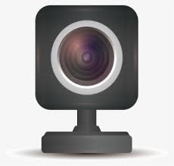
ARCHITECTURE
INPUT VIDEO (Live Stream)
OPEN CV
FRAME BY FRAME IMAGES
FEATURE EXTRACTION
CAMERA OR WEBCAM
LIVE VIEWED IN DIALOG BOX
USE MODEL MOBILENET SSD
IF NO
IF NO
MS COCO IMAGE DATASET
GENERATE AN ALERT/SIREN AND INFORM THE USER.
IF YES
IS IT AN ANIMAL?
IF YES
ANY OBJECT DETECTED?
VGG NET LAYER
CNN LAYER

Slide 13
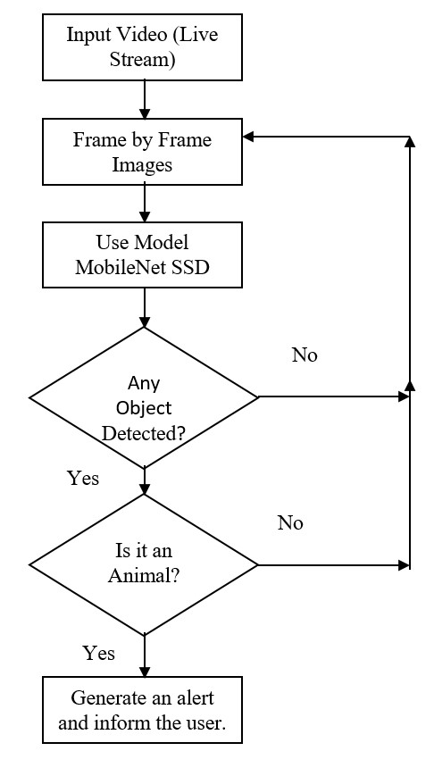
PROJECT FLOW
The flow for the project is given below

Slide 14
MODULES
UPLOAD (LIVE)
VIEW
PREPROCESSING
THE MODEL TRAINING
PREDICTION
USER INTERFACE

Slide 15
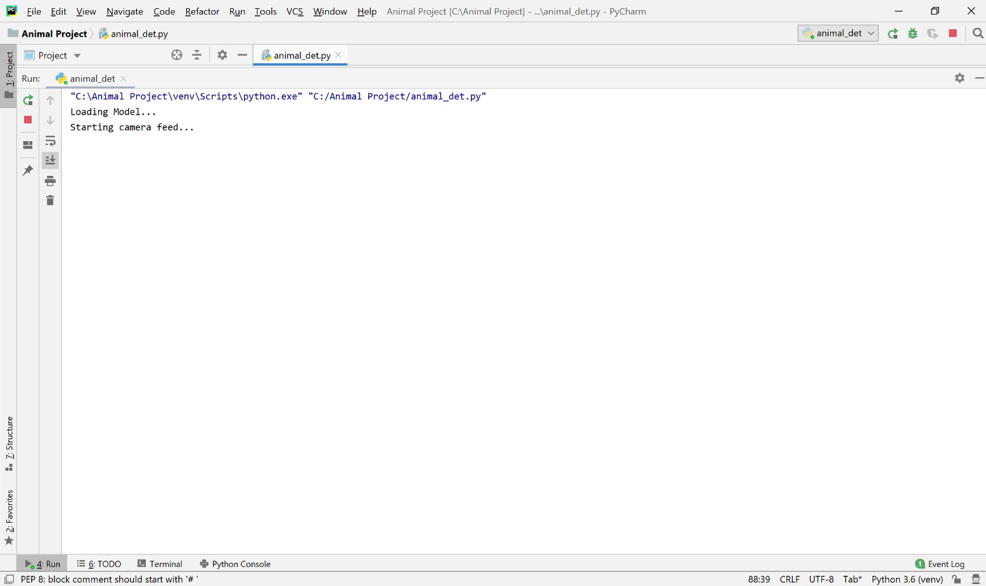
Upload (Live):
Upload a video as a live feed using a webcam (or any camera attached in a farm).
Window of starting camera feed (live)

Slide 16
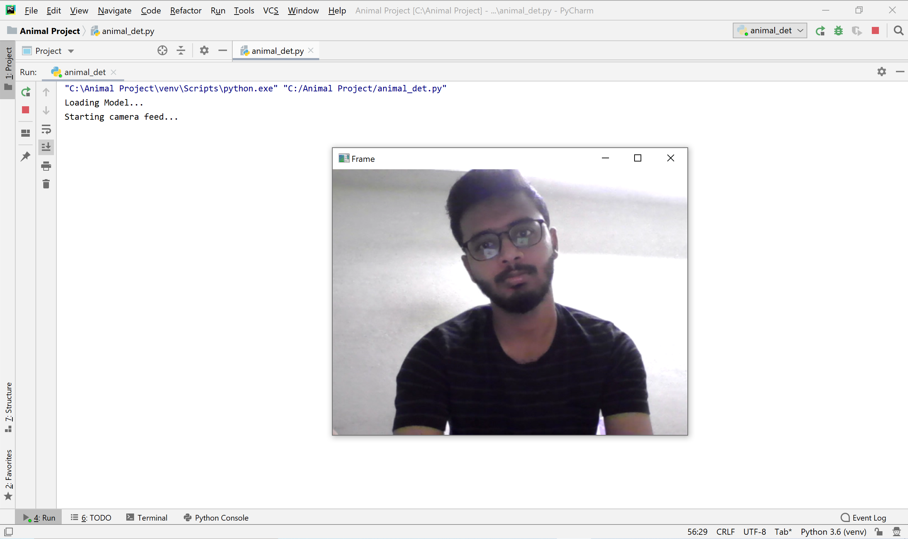
View:
Video can be viewed live in a dialog box.
Viewing a man in input live video streaming

Slide 17
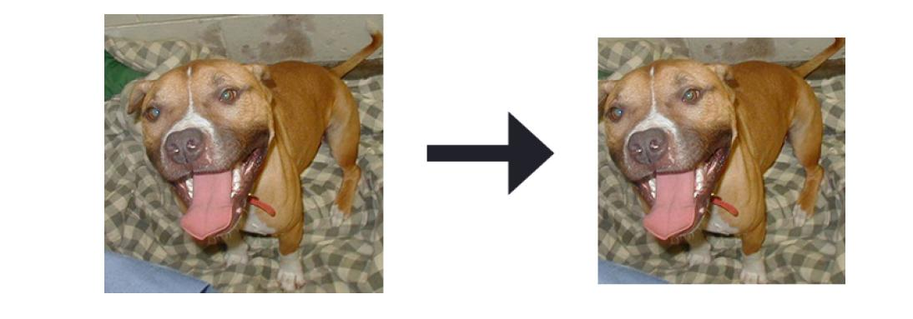
Preprocessing:
Data Preprocessing is a technique that is used to convert the raw data into a clean data set. Cleaning the data refers to removing the null values, filling the null values with meaningful value, removing duplicate values, removing outliers, removing unwanted attributes. If dataset contains any categorical records means convert those categorical variables to numerical values.
In this case, we are taking a live video feed in the form of images and resizing them to a standard size. We use MobileNet SSD pretrained model which identifies features in any image using a Convolution Neural Network (CNN) model.
Input image and Preprocessing image

Slide 18
The Model Training:
SSD (Single Shot Detector) is a popular algorithm in object detection.
It’s generally faster than RCNN.
SSD has two components: a backbone model and SSD head. Backbone model usually is a pre-trained image classification network as a feature extractor.
Here, we will use MobileNet SSD model to detect the objects.
Here, VGG Net is used as a backbone model to extract the features from the images. Convolution layers (CNN) are then used for object detection in the images using the feature map generated by VGG net layer.
The model is able to detect multiple objects in any given image.

Slide 19
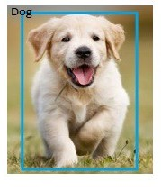
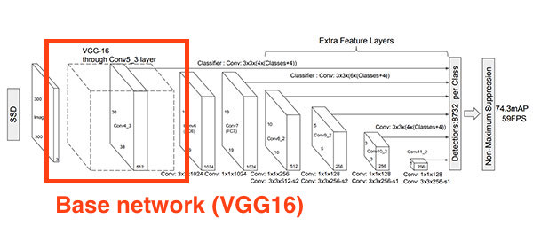
For the purpose of classification, the model uses softmax in the last layer.
Softmax converts logits into probabilities by taking the exponents from every output and then normalize each of these numbers by the sum of such exponents, such that the entire output vector adds up to one.
The Model training (base network VGG16)
Object detected image (dog)

Slide 20
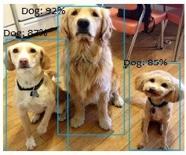
Prediction:
A live video feed is taken in frame by frame as individual images. These images then fed into the model after preprocessing to detect animals (if any exists).
Predicting the object image if it is animal or not

Slide 21

User Interface:
A dialog box opens up while taking in the live video feed. The frames or images from the video are used to detect objects.
The objects are then bounded in a bounding box along with a label and the probability of success in also displayed in there.
A siren is then played if any animal is detected for a while.
Siren played and Alert given to the Farmer

Slide 22
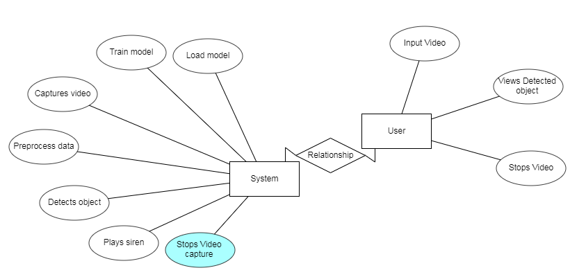
UML DIAGRAMS
USECASE DIAGRAM & ER DIAGRAM

Slide 23
CLASS DIAGRAM & SEQUENCE DIAGRAM

Slide 24
COLLABORATION DIAGRAM & DEPLOYMENT DIAGRAM

Slide 25
COMPONENT DIAGRAM & ACTIVITY DIAGRAM

Slide 26
TESTING
A Camera will be placed at different locations in the farm (coveniently where animals enter from).
To process the live video feed the system uses OpenCV (live video - input). The pretrained model which is trained, is used to detect object.
Then the model predicts the object and if the object is animal then an alert is sent to the farmer and to divert animal an siren will be played.
CONDITIONS
If the pretrained model detects animal then the result is success.
If the pretrained model detects humans then the result is failure.
If the pretrained model detects any other intrusion then the result is failure.

Slide 27
TESTCASES
TESTCASES | INPUT | RESULT | REASON
Case (i) | ANIMAL INTRUSION | SUCCESS | SATISFIED
Case (ii) | HUMAN INTRUSION | FAILURE | UNSATISFIED
Case (iii) | ANY OTHER INTRUSION | FAILURE | UNSATISFIED

Slide 28
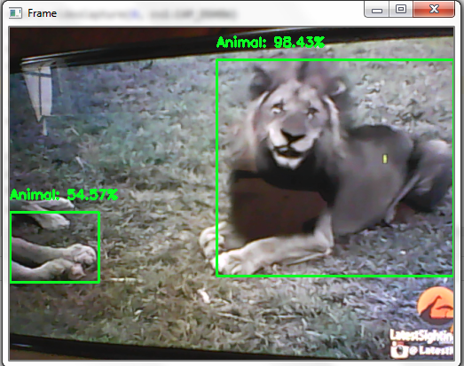
TESTING THE TESTCASES
Case (i)
Input:
Animal Intrusion

Slide 29
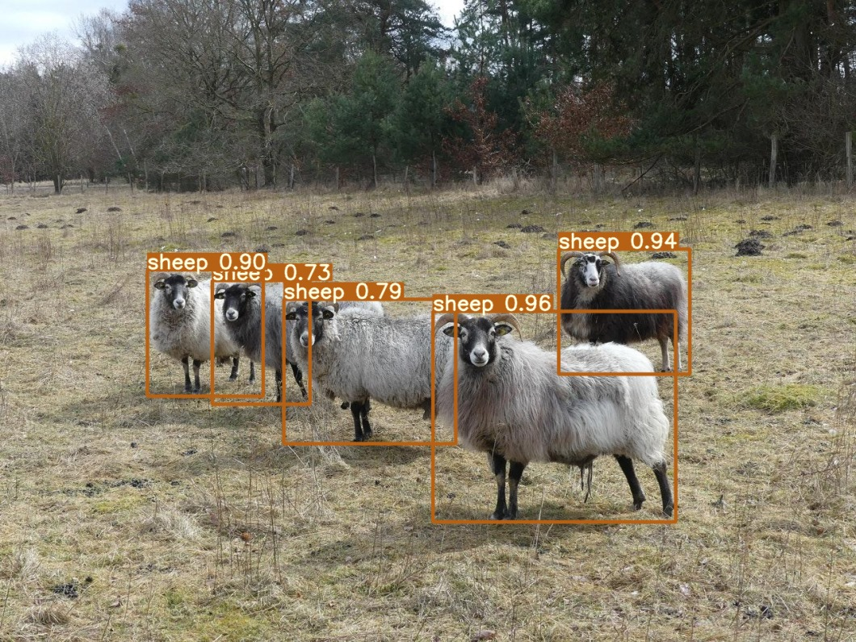
TESTING THE TESTCASES
Case (i)
Input:
Animal Intrusion

Slide 30
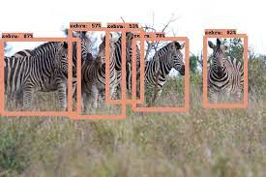
TESTING THE TESTCASES
Case (i)
Input:
Animal Intrusion

Slide 31
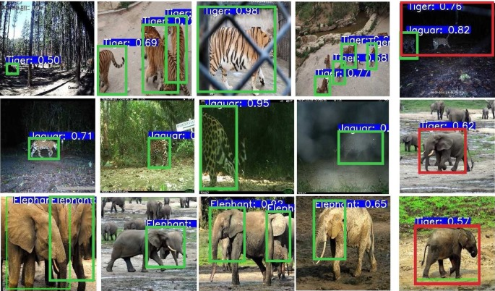
TESTING THE TESTCASES
Case (i)
Input:
Animal Intrusion

Slide 32
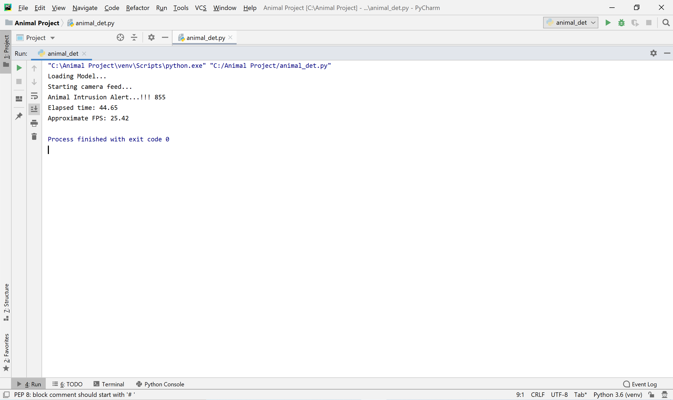
Output:
Window of Animal Intrusion
Here, a siren is played in the farm as Animal Intrusion taken place. To distract the Animals before they start the damage. And also an alert will be generated to the Farmer that “Animal Intrusion”.

Slide 33
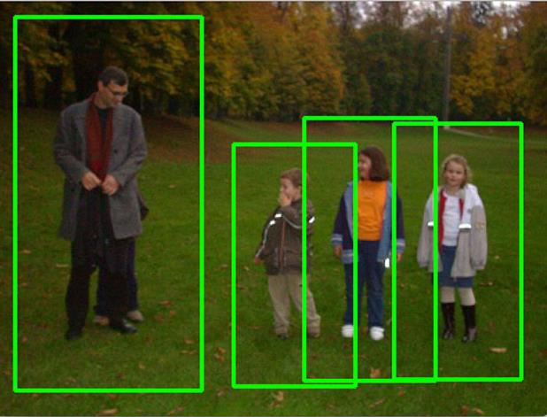
Case (ii)
Input:
Human Intrusion
Output:
Live Stream continues as no animal intrusion taken place. The process continues until animal is detected.

Slide 34
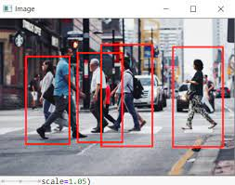
Case (ii)
Input:
Human Intrusion
Output:
Live Stream continues as no animal intrusion taken place. The process continues until animal is detected.

Slide 35
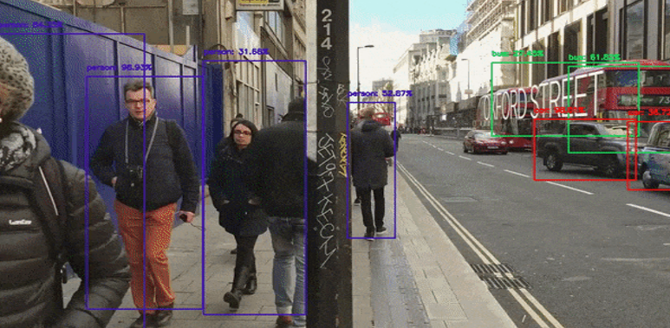
Case (iii)
Input:
Any Other Intrusion
Output:
Live Stream continues as no animal intrusion taken place. The process continues until animal is detected.

Slide 36
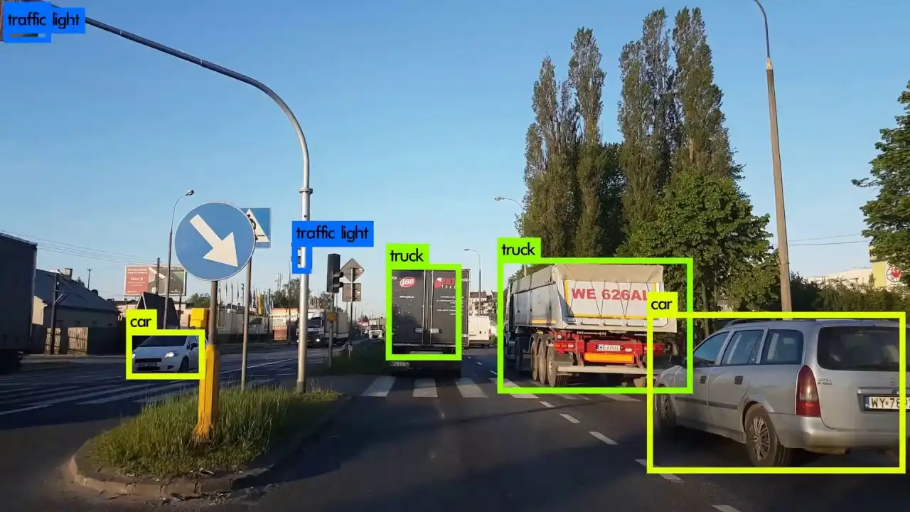
Case (iii)
Input:
Any Other Intrusion
Output:
Live Stream continues as no animal intrusion taken place. The process continues until animal is detected.

Slide 37
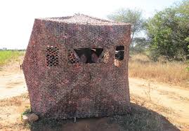
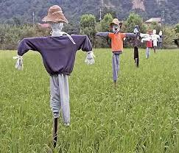
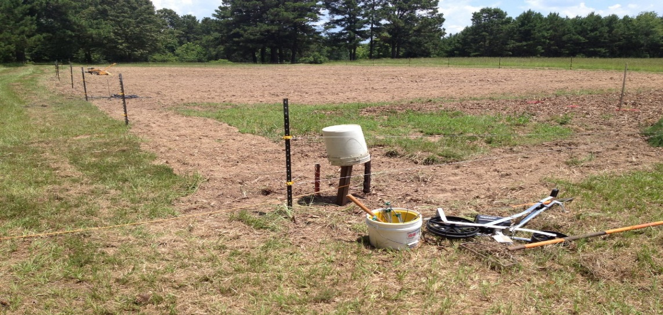
EXISTING METHOD PICTURE
The Existing Method is most of the farmers rely on medieval techniques like using:
Scarecrow.
Relying on guards to monitor crops.
Protecting using electric fencing.

Slide 38
RESULTS
The proposed scheme presents a novel approach to detect for any intrusion in farms.
This approach has been implemented by the using neural networks.
We have successfully developed a deep learning model using the deep neural network architecture to detect the presence of any animal in the farm.
We were able to get a net frame rate of 18 frames per second (approximately).

Slide 39
Comparison on our results with existing and current related work:
In existing farmers is used scarecrow & guards for monitoring crops, but this method won’t be helpful in different climatic conditions and moreover time is wasted in this situation. And using electric fencing is a good solution but some government opposes this as illegal, and it may be a threat to wildlife too. While comparing with our proposed system results it detects animals in any condition like light, weather and so on. And mainly detects the animal and intimates the farmer and if he/she is not in range to farm then it will start a smoke to diver animals.
Comparison on our results with state of art method:
We have selected an advanced algorithm that have been proposed to perform tasks, we will take data from a dialog box that too live data and then that data is cleaned and preprocessed and sent into the model and the model is trained on MobileNet SSD and that will predict whether it is an animal or not. It predicts with good accuracy of 100%. The model can predict animals at any climatic condition that prompts us to the robustness of the system.

Slide 40
CONCLUSION
The problem of damaging crops by wild animals has become a major social problem in the current time. It requires urgent attention and an effective solution. The proposed method allows us to detect any animal presence or intrusion in farms using video from any camera device placed in the farms. The object detection model worked almost consistently at 18 frames per second.
It is a cheap and robust system. The siren scares the intruders away as well as it can alert the farmer to take action. Thus, this application can be used to protect crops in the farm. It might be very useful for agricultural purposes instead of traditional methods used today.
In this process while detecting the animals, the surveillance system also detects human as animal if the human behaves like an animal or even acts as any animal behaviour. The proposed system achieves an accuracy of 100% regarding animal detection. Thus, it can be concluded from the above discussion that a reliable, secure, fast and efficient system has been developed replacing a manual and unreliable system. Hence this system can be implemented for better results regarding the animal detection.
.

Slide 41
FUTURE ENHANCEMENTS
The methods to scare away the intruders can be changed in future. We may even employ a laser based system instead of just an siren to do so. It can also be embedded in an IoT based system for easy utilization.

Slide 42
LEARNING OUTCOMES
Importance of classification.
Scope of animal detection.
Use of computer vision techniques.
Importance of PyCharm IDE.
Benefits of Mobile Net model.
What is OpenCV?
Need of using pre trained model.
Process of debugging a code.
Input and Output modules
How test the project based on user inputs and observe the output

Slide 43
Practical exposure to
Hardware and software tools.
Solution providing for real time problems.
Working with team/ individual.
Work on Creative ideas.

Slide 44
REFERENCES
[1] https://www.ijraset.com/research-paper/animal-detector-system-for-forest-monitoring-using-opencv-and-raspberry-pi
[2] https://www.researchgate.net/publication/372165159_ANIMAL_DETECTION_IN_FARMS_USING_OPENCV
[3] https://ijsrem.com/download/animal-detection-in-farms-using-opencv/

Slide 45


Slide 46
THANK YOU

